Slide 1
Automatic Intonation Event Detection Using Tilt Model for Croatian Speech Synthesis
Lucia Načinović, Miran Pobar, Sanda Martinčić-Ipšić and Ivo Ipšić
Department of Informatics, University of Rijeka
lnacinovic, mpobar, smarti, ivoi @inf.uniri.hr
InFuture 2011

Slide 2
Content
Introduction
Tilt model overview
Intonation event detection
Speech database, hand-labelling, F0 feature sets extraction, HMM training, F0 generation
Results
Conclusion and future work

Slide 3
Introduction
Prosody – plays great role in intelligebility and understanding of speech
Comprised of prosodic features: intonation, prominence, timing, phrasing, voice quality, rhythm etc.

Slide 4
Prosody in a TTS system
TTS System
Input
Text Analysis
Text Normalization
Phonetic Analysis
G2P Conversion
Prosodic Analysis
Pitch & Duration
Speech Synthesis
Voice Rendering
Speech Signal

Slide 5
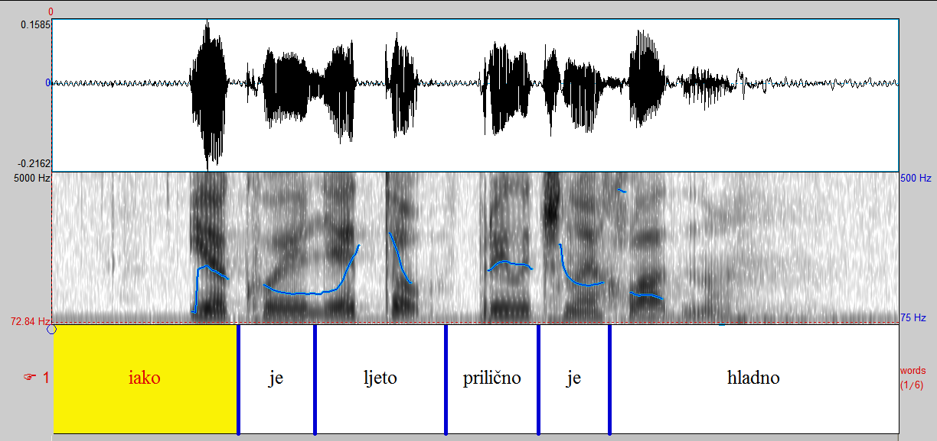
Structure
Refers to the fact that some words group together forming prosodic phrases and some have a break between them
At the boundaries between prosodic phrases – often a change of rythm or a pause

Slide 6
Prominence
Some words within prosodic phrase and some syllables within words more prominent – stand out to a greater extent
Example of a Croatian word with marked accent:
dokùment

Slide 7
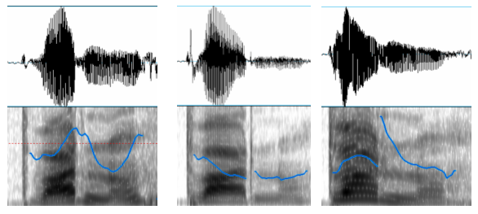
Tune
Each prosodic phrase can have one of a number of tunes associated
Most important part of intonational tune: pitch
Utterance “stvârno” pronounced in a “sceptical” manner, “excited” manner and “angry” manner:

Slide 8
Intonation models
According to the manner of generation:
Linear or tone sequence – generate values from left to right as a sequence of values or movements (ToBI, Tilt)
Superpositional or hierarchical – generate a contour by modeling factors separately and then combining the partial models (Fujisaki)

Slide 9
Intonation models II
According to the representation of the F0 contour:
Phonological – use a set of abstract phonological categories; each category has its own linguistic function (ToBI)
Phonetic – describe f0 contour using a set of continuous parameters (Tilt, Fujisaki)

Slide 10
Tilt intonation model
Phonetic model
Basic units:intonational events
linguistically relevant parts of the F0 contour
Based on a simpler model
RFC model
R-rise,
F-fall,
C-connection

Slide 11
RFC parameters in Tilt model
rise
fall
rise
amplitude
A_{rise}
The RFC parameters for an utterance are:
rise amplitude (Hz)
rise duration (seconds)
fall amplitude (Hz)
fall duration (seconds)
position (seconds)
F0 height (Hz)
fall
amplitude
A_{fall}
rise
duration
D_{rise}
fall
duration
D_{fall}
position
vowel

Slide 12
Transformation of RFC parameters into Tilt parameters
tilt-amplitude (Hz): the sum of the magnitudes of the rise and fall amplitudes
tilt-duration (seconds): the sum of the rise and fall durations
tilt: a dimensionless number which expresses the overall shape of the event, independent of its amplitude or duration

Slide 13
Intonation event detection
An automatic HMM based procedure for detecting events and labelling speech database used
For each prosodic event separate HMM constructed
In HMM training hand-labelled utterances and original F0 used

Slide 14
Speech database
1 hour and 54 minutes of speech from a collection of fairy tales
One speaker
100 utterances hand-labelled
75 for HMM training
25 for testing

Slide 15
Hand-labelling
Three elements of prosodic event labelled:
peek (a)
start (b)
end (c)
silences (sil)

Slide 16
F0 feature set extraction
RAPT algorithm used in F0 features extracting
The obtained F0 contoures contained noise
3 types of results:
Raw output
Smoothed
Interpolated

Slide 17
Automatic event recognition
HMMs trained with Baum-Welch algorithm on extracted F0 features and hand-labelled prosodic events positions
For all three F0 feature types different HMM set trained
Grammar with permitted combination of events defined

Slide 18
Tilt analysis and synthesis
Tilt parametrs are associated with each detected event
From tilt/RFC parameters, we can generate F0 contours using tilt synthesis and given equations:
F0(t) = A_{abs} + A – 2.A.(t/D)² 0 < t < D/2
F0(t) = A_{abs} + 2.A.(1 - t/D)² D/2 <t < D

Slide 19
Results
measure for evaluating generated F0 contour is the root mean square error (RMSE) between the original contour and the obtained generated F0 contour
Event label model | RMSE (Hz)
raw | 25.16
smoothed | 26.69
interpolated | 25.57
hand-labelled | 23.11

Slide 20
Comparison of the generated f0 contours with the original f0

Slide 21
Conclusion and future work
All F0 contours obtained from automatically detected events perform comparably to the hand-labelled case
Possible improvements:
Increasing the number of hand-labelled utterances
Improving the precision of hand-labelled event boundaries using an automated procedure for searching the optimal position of the boundary by trying several positions in the vicinity of labelled boundary and noting the change in the observed RMSE
Building CARTs for predicting Tilt parameters based on linguistic features extracted from text

Slide 22
Automatic Intonation Event Detection Using Tilt Model for Croatian Speech Synthesis
Lucia Načinović, Miran Pobar, Sanda Martinčić-Ipšić and Ivo Ipšić
Department of Informatics, University of Rijeka
lnacinovic, mpobar, smarti, ivoi @inf.uniri.hr
InFuture 2011

Slide 23
References
Aylett, M.P.; Fackrell, J.; Rutten, P. My voice your prosody: Sharing a speaker specific prosody model across speakers in unitselection tts. // Eurospeech. 2003; 321-324.
Bakran, J.; Erdeljac, V.; Lazić, N. Modeliranje temeljnih intonacijskih oblika. // Govor. vol. 18 (2001); 105-111.
Blin, L.; Miclet, L. Generating synthetic speech prosody with lazy learning in tree structures. // CoNLL-2000 and LLL-2000. 2000; 87–90.
Dusterhoff, K.E.; Black, A.W.; Taylor P. Using decision trees within the tilt intonation model to predict f0 contours. // Eurospeech. 1999; 1627–1630.
Fujisaki, H.; Ohno. Analysis and modeling of fundamental frequency contours of English utterances. //Speech Communication. 2005; 47:59-70.
Meron, J. Prosodic unit selection using an imitation speech database. // 4th ISCA Workshop on Speech Synthesis. 2001; 53-57.
Mikelić Preradović N. Pristupi izradi strojnog tezaurusa za hrvatski jezik. Ph.D. thesis, University of Zagreb. 2008.

Slide 24
References II
Rojc, M.; Agüero, P.D.; Bonafonte, A.; Kacic, Z. Training the Tilt intonation model using the JEMA methodology. // Eurospeech. 2005; 3273-3276.
Silverman et al. ToBI: A standard for labeling English prosody. // ICSLP92. 1995; 2:867-870.
Sjölander, K.; Beskow, J. Wavesurfer – An open source speech tool. // Interspeech. 2000; 464-467.
Talkin, D. A robust algorithm for pitch tracking (RAPT). // Spech coding and synthesis. 1995; 495-518.
Taylor, P. Analysis and synthesis of intonation using the tilt model. // The Journal of the Acoustical Society of America.2000; 1697-1714.
Taylor, P. 1995. The rise/fall/connection model of intonation. // Speech Communication. vol. 15 (1995); 169–186.

Slide 25
References III
[1]D. Jurafsky and J. H. Martin, Speech and Language Processing. Boulder: Prentice Hall, 2000.
[2]L. Wheeldon and A. Lahiri, "Prosodic units in speech production," Journal of Memory and Language, vol. 37, pp. 356-381, 1997.
[3]J. Hirschberg, "Pitch accent in context: Predicting intonational prominence from text," Artificial Intelligence, vol. 63, pp. 305-340, 1993.
[4]M. Ostendorf and N. Veilleux, "A hierarchical stochastic model for automatic prediction of prosodic boundary location," Computational Linguistics, vol. 20, pp. 27-54, 1994.
[5]K. Silverman et al., "ToBI: A standard for labeling English prosody," in Proceedings of ICSLP92, 1992, pp. volume 2, pages 867-870.
[6]P. Taylor, "Analysis and synthesis of intonation using the tilt model," The Journal of the Acoustical Society of America, vol. 107, p. 1697, 2000.
[7]H. Fujisaki and S. Ohno, "Analysis and modeling of fundamental frequency contours of English utterances," in Speech Communication, 2005, pp. Volume 47, Issues 1-2, Pages 59-70.
[8]N. Mikelic Preradovic, Pristupi izradi strojnog tezaurusa za hrvatski jezik.: University of Zagreb, 2008.
[9]J. Bakran, V. Erdeljac, and N. Lazic, "Modeliranje temeljnih intonacijskih oblika," Govor(Zagreb), vol. 18, pp. 105-111, 2001

Slide 26
References IV
[10]C.W. Wightman, "ToBI or not ToBI?," in Speech Prosody 2002, 2002.
[11]M. Pobar, S. Martinčić-Ipšić, and I. Ipšić, "TEXT-TO-SPEECH SYNTHESIS: A PROTOTYPE SYSTEM FOR CROATIAN LANGUAGE," Engineering Review, vol. 28, 2008.
[12]A.W. and Taylor, P. and Caley, R. Black, Festival speech synthesis system: system documentation.: Human Communication Research Centre, 1997.
[13]M.E. Beckman and G.A. Elam, "Guidelines for ToBI labelling," The OSU Research Foundation, vol. 3, 1997.
[14]K. Carlson, C. Clifton, and L. Frazier, "Prosodic boundaries in adjunct attachment," Journal of Memory and Language, vol. 45, pp. 58-81, 2001.
[15]S. Narusawa, N. Minematsu, K. Hirose, and H. Fujisaki, "A method for automatic extraction of model parameters from fundamental frequency contours of speech," in IEEE; 1999, vol. 1, 2002.
[16]J.J. Venduti, Japanese ToBI labelling guidelines.: Ohio State University, 1995.
[17]E. Campione and J. Veronis, "A multilingual prosodic database," in Proceedings of ICSLP, 1998.

Slide 27
Performance for different feature sets
Feature set | Correctness
F0 raw | 45.62
F0 smoothed | 53.75
F0 interpolated | 45.77
Correctness computed using Levenshtein distance between automatically generated and hand-labelled event labels

